Slide 1
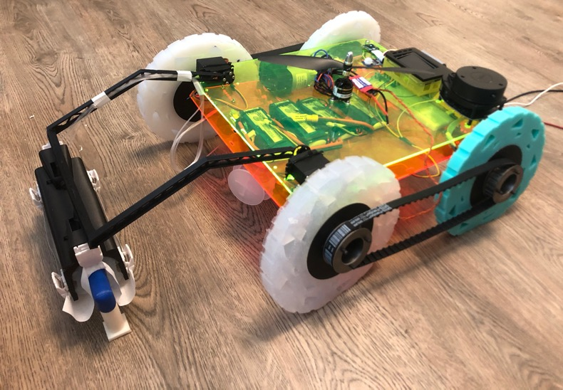
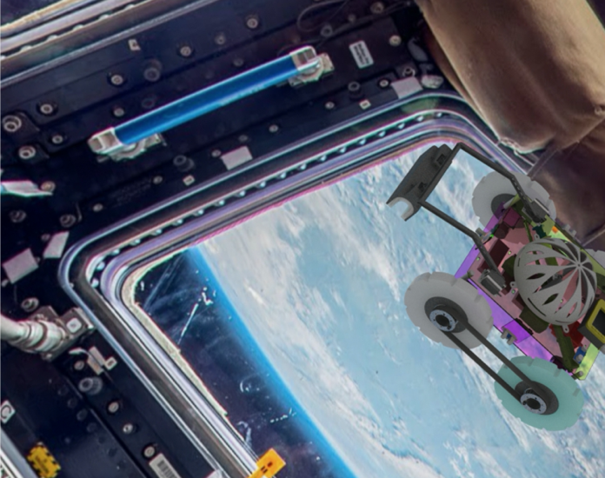
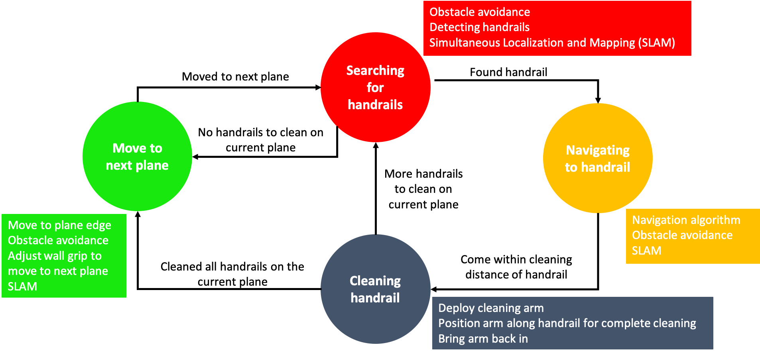
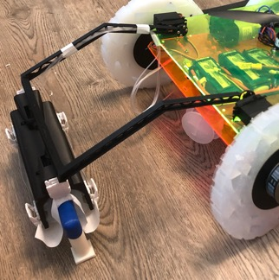
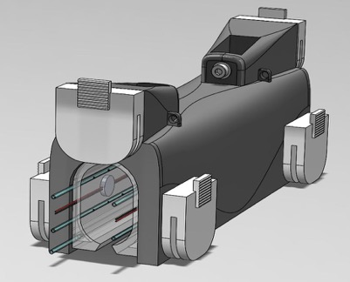
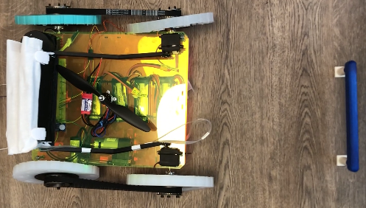
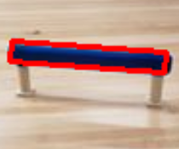
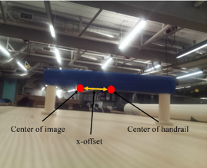
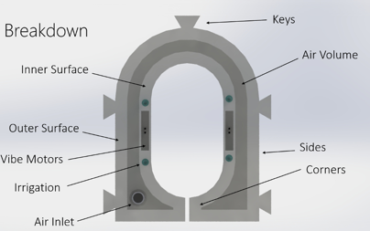
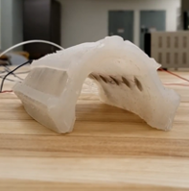
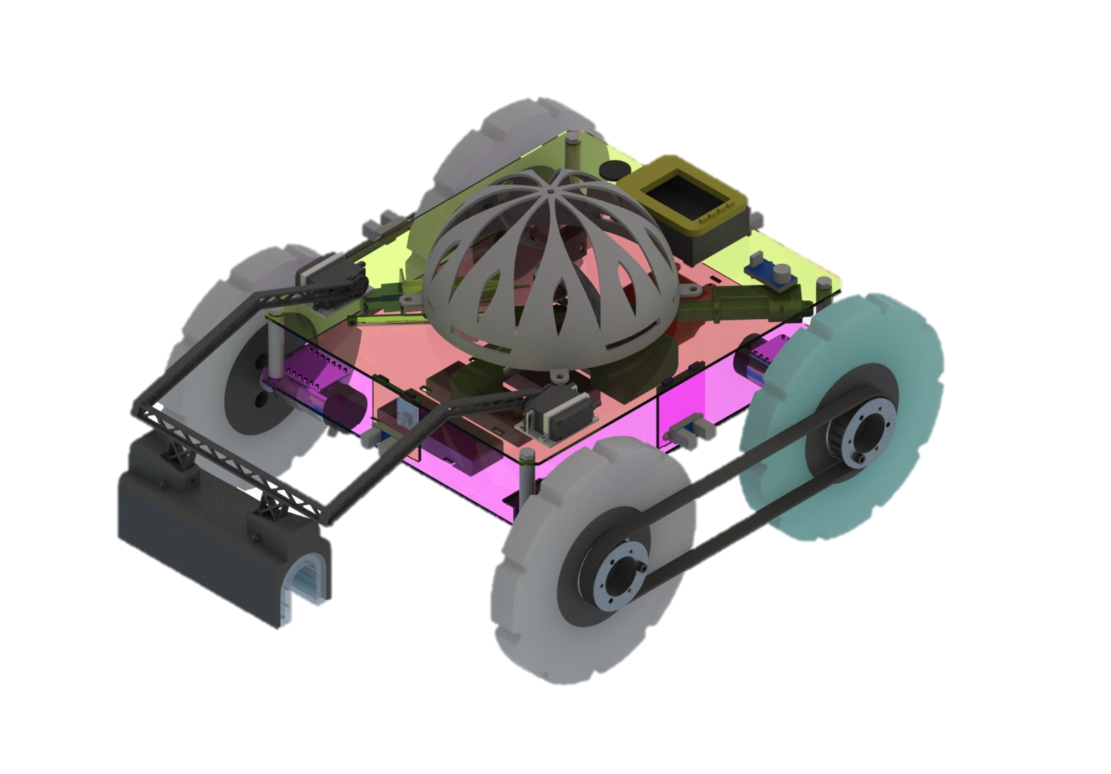
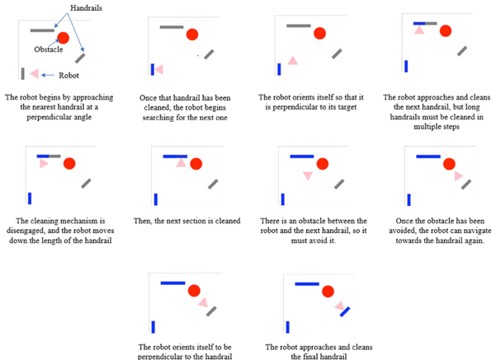
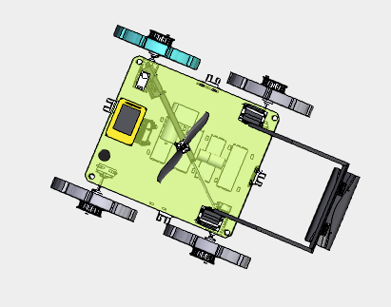
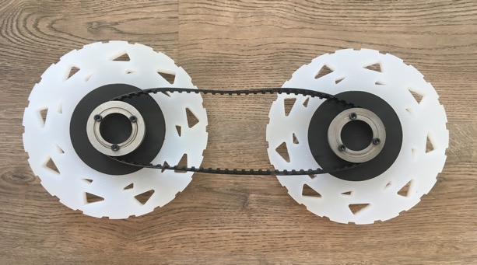
International Space Station Servicing Robot
2020 International Space Station Research and Development Conference
Authors: Samantha Glassner, Lamia Farah, Daniel Fisher, William Spencer, Erica Traini, and Dr. Marilyn Minus Department of Mechanical Engineering, Northeastern University
Astronaut time aboard the International Space Station (ISS) is in short supply and extremely valuable. While most of their time on the ISS is spent contributing to groundbreaking experiments, they also must perform monotonous maintenance tasks. An example of one of these tasks is the routine cleaning of handrails that the astronauts use to traverse the inside of the ISS. This team dedicated their senior capstone research project to designing and prototyping an autonomous robot that will navigate along the internal walls of the ISS to perform an example servicing task of cleaning blue handrails; freeing astronaut time for more scientific experimentation. The main design focus-areas were condensed into (1) Cleaning, how the robot will clean the handrails; (2) Navigation, how the robot will traverse the ISS; and (3) Locomotion, how the robot will move and navigate the ISS in zero-gravity. A design comprised of a four wheeled robot, a novel soft robotic cleaning mechanism, and an on-board Raspberry Pi controlled Simultaneous Localization and Mapping (SLAM) and handrail detection system was created.
Navigation
Analytical Investigation
To help understand the geometric constraints of the vehicle, the team has simulated an accurate rendition of the vehicle in CAD. Using this model, the robot’s ability to navigate the corners and steps of the space station, as well as the ability to drive over obstacles, was confirmed. The team simulated vehicle operations using Matplotlib python plotting. Acoustic analysis was employed to determine that the vehicle satisfies ISS environmental requirements for noise. The quality of the wetting of the wipe, the intensity of the vibration, as well as the inflation of the soft robot were guided by simulation methods and empirical data, and were demonstrated using the first version of the soft robot. The accuracy of the camera’s handrail detection, as well as the determination of the handrail distance, was tested by doing static tests with a 3D printed mock handrail.
Cleaning
To allow the robot to “see” handrails and obstacles while knowing its position in space the following solutions were considered: Light Detection and Ranging (LiDAR) cameras to avoid obstacles and detect specific objects, using a series of Infrared (IR) sensors to construct a map of an environment, and SLAM methods utilizing camera inputs to localize a robot in space. These solutions were combined in a way that limited complexity and cost by using a 2D camera to detect handrails, a 2D LiDAR to implement a SLAM algorithm and a series of infrared cameras to avoid obstacles.
Operations
A program deciphers images taken on the camera and segments out the pixels that match the characteristics of a handrail: that is must be blue, and it must create a rectangular shape. Once the robot has identified a handrail, it navigates to the handrail using SLAM to keep track of its position and IR sensors to avoid obstacles. The cleaning mechanism is deployed over the handrail and inflated to grip. A small amount of cleaning solution is applied to the cleaning wipe via irrigation lines cast into the soft robot. The soft robot applies mechanical cleaning via vibration, and ends the cleaning sequence.
The cleaning mechanism extends from the robot body to clean a handrail. To minimize complexity, a simple one degree of freedom arm was chosen. For the arm to grip the handrail, the group examined using both a soft robotic end effector and a mechanical jaw. The soft robot was chosen, as its inherent compliance makes contact on the cleaning surface more reliable. The team decided to apply mechanical cleaning with embedded vibration motors, rather than having it slide along the handrail as it was less complex mechanically and electrically. When deciding on the cleaning material to interface with the mechanism, the group examined using a pre-moistened wipe and a dry wipe that would have liquid dispensed onto it. Trade studies showed the dry wipe solution would reduce the risk of liquid releasing from the mechanism, a risk to the station, and could be reused more often, making it the clear solution. Irrigation lines are embedded in the soft robot to wet the cleaning wipe as necessary.
Locomotion
The locomotion aspect of the robot consisted of how the robot would move through the ISS in addition to how it would adhere to the walls of ISS in zero-gravity. To move through the ISS, a four-legged robot design and a tank-drive wheeled robot design were both examined. Vacuum suction cup methods, a pinching mechanism and a propeller were all considered in deciding how the robot would adhere to the walls of the ISS. To limit the complexity of navigating certain corners of the ISS and turning, the wheeled robot with tank-drive wheels was chosen. A ducted propeller was chosen to keep the vehicle adhered to the walls.
Presenter
Samantha Glassner
glassner.s@northeastern.edu
Notes:
International Space Station Servicing Robot
Authors: Samantha Glassner, Lamia Farah, Daniel Fisher, William Spencer, Erica Traini, and Dr. Marilyn Minus
Department of Mechanical Engineering, Northeastern University
Astronaut time aboard the International Space Station (ISS) is in short supply and extremely valuable. While most of their time on the ISS is spent contributing to groundbreaking experiments, they also must perform monotonous maintenance tasks. An example of one of these tasks is the routine cleaning of handrails that the astronauts use to traverse the inside of the ISS. This team dedicated our senior capstone research project to designing and prototyping an autonomous robot that will navigate along the internal walls of the ISS to perform an example servicing task of cleaning blue handrails; freeing astronaut time for more scientific experimentation. The main design focus-areas were condensed into (1) Cleaning, how the robot will clean the handrails; (2) Navigation, how the robot will traverse the ISS; and (3) Locomotion, how the robot will move along the ISS walls in zero-gravity. A design comprised of a four wheeled robot, a novel soft robotic cleaning mechanism, and an on-board Raspberry Pi controlled Simultaneous Localization and Mapping (SLAM) and handrail detection system was created.
Section 1: Cleaning
A soft robotic cleaning mechanism was designed with cleaning solution irrigation tubes and vibration motors embedded in the silicon. This soft component was encased in a hard 3d printed housing with clip in points for the astronauts to install a lint-free wipe. The cleaning mechanism was connected it to the robot with a single degree of freedom arm.
Section 2: Navigation
To allow the robot to “see” handrails and obstacles while knowing its position in space the following sensors and cameras were utilized: (1) a 2D camera was used to detect handrails, (2) a 2D Light Detection and Ranging (LiDAR) to implement a SLAM algorithm to construct a map of an environment and localize the robot in space, and (3) infrared (IR) distance sensors and passive infrared (PIR) motion detection sensors to avoid fixed and moving obstacles respectively.
Section 3: Locomotion
The locomotion aspect of the robot consisted of how the robot would move through the ISS in addition to how it would adhere to the walls of ISS in zero-gravity. To limit the complexity of navigating certain corners of the ISS and turning, the wheeled robot with tank-drive wheels was chosen. The two drive motors were equipped with encoders to feed back into the navigation system. A ducted propeller was mounted to the top of the robot to provide continuous down force to keep the vehicle adhered to the walls.
Section 4: Analytical Investigation
To help understand the geometric constraints of the vehicle, the team has simulated the robot’s ability to navigate the corners and steps of the space station, as well as the ability to drive over obstacles, was confirmed. The team simulated vehicle navigation operations using Matplotlib python plotting. Acoustic analysis was employed to determine that the vehicle satisfies ISS environmental requirements for noise. The quality of the wetting of the wipe, the intensity of the vibration, as well as the inflation of the soft robot were guided by simulation methods and empirical data, and were demonstrated using the first version of the soft robot. The accuracy of the camera’s handrail detection, as well as the determination of the handrail distance, was tested by doing static tests with a 3D printed mock handrail.
Section 5: Operations
A program deciphers images taken on the camera and segments out the pixels that match the characteristics of a handrail: that is must be blue, and it must create a rectangular shape. Once the robot has identified a handrail, it navigates to the handrail using SLAM to keep track of its position and IR sensors to avoid obstacles. The cleaning mechanism is deployed over the handrail by rotating the attaching arm. The soft robot is inflated to grip. A small amount of cleaning solution is applied to the cleaning wipe via irrigation lines cast into the soft robot. The soft robot applies mechanical cleaning via vibration, once leaning is complete the soft robot deflates and the arm rotates up to disengage the handrail. The cleaning mechanism was designed to clean the width of the shortest handrail, for longer handrails the robot would drive down the side of the rail and then repeat the steps until the entire handrail was clean. Once the robot cleans all handrails on a given plane it will move to the next plane. This process would be repeated for all planes of the ISS interior.

